Slide 1
Meet the Teacher Lower Juniors September 2018

Slide 2
Welcome!
Welcome to the Lower Junior meet the teacher session.
Please ensure you have signed in to help us check who has received the new parent pack and home school agreement.
Please read through the home school agreement and return the signed slip back to school.

Slide 3
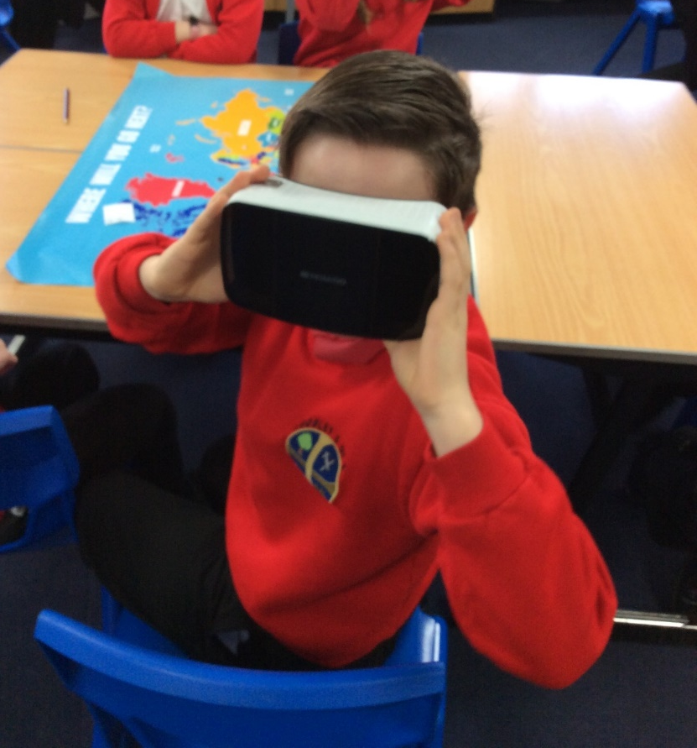
The Lower Juniors
Don’t worry, the juniors has many similarities to the infants.
But most importantly – the fun will continue!

Slide 4
The Classes

Slide 5
Maple
Mrs Poole
Mrs Blakely
Mrs Pearce

Slide 6
Rowan
Miss Minchinton
Mrs Rozzier
Mrs Pegg
Miss Davis

Slide 7
Cedar
Mrs Boulton
Mrs Marsh

Slide 8
Support Staff & Cover.
Mrs Wallace/Mr Miles German language and ICT for Y3/4
Mr Clare PE Coach
Mr Blakely Instrumental tuition for Y4
.

Slide 9
What is the same? – Curriculum.
Subjects. – The subjects covered:
English
Maths
Science
Topic (History/Geog)
P.E
German
Music
Art / DT
ICT / Computing
R.E /PSHE
These subjects are delivered with a cross-curricular approach and our timetable always remains flexible.
Notes:
Year 4 parents will need to bring

Slide 10
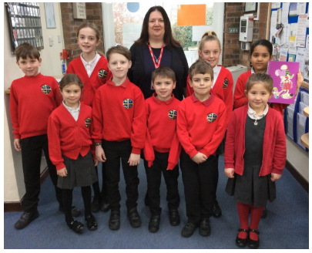
What is the same? – Uniform
Clothing for Junior children is the same as for infants.
Children can wear a white or red polo shirt and a choice of a red school top with grey trousers, shorts or a skirt.
Book bags (Please do not send your child in with a large bag, there just is not room in the cloakrooms for them.)
Notes:
Suitable shoes are to be worn at all times. Please no open-toed sandals or shoes with heels.

Slide 11
What is the same? – P.E Kit.
A named P.E kit must be in school at all times.
A full kit consists of:
A white T-Shirt.
Red shorts.
Sports Trainers (check they fit throughout the year!)
Sports Jumper.
Tracksuit bottoms (optional)
If possible ear-rings should not be worn on P.E days. However, if newly pierced you will need to provide tape for the class teacher. Long hair must be tied back.
Other Jewellery.
Donations of spare kits?
Notes:
(hair, jewellery, plimsoles, donations of spare kits from older children. )

Slide 12
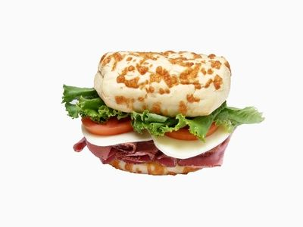
Lunch & Snacks.
The school will continue to use the existing catering company
Meals will cost £2.05
Orders must be in by midnight the day before.
Fruit can be brought in for break time.
Please bring in a named bottle of water for your child. This should be in addition to your child’s lunchtime drink.
Packed lunches – eat in the classroom when weather is wet and playground when warm and dry.
School dinners – eat in dining area.
Notes:
(discussion about good choices of snack)

Slide 13
What is different? - Timings
J Poole
Children can arrive between 8:40 – 8:50. If they arrive after 9:00 they should enter the school through the office.
Children who arrive after the registration period will be marked as late.
Children are not to enter the school before 8:40 please.
They are also not permitted to wait around on site before 8:40.
On arrival at school the children are to go straight to class to begin their morning work.
Notes:
Explain morning work.

Slide 14
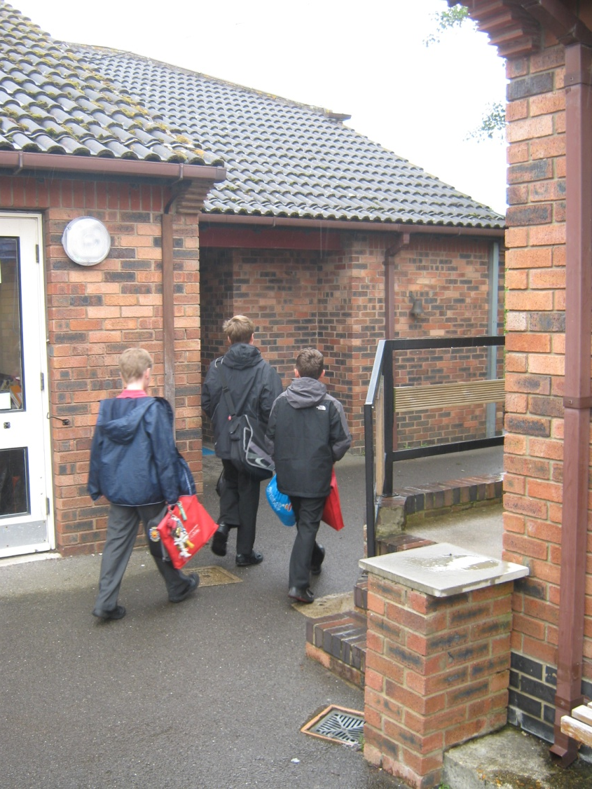
Where your child enters the building in the morning.
L Powell
All children enter
through the school
by Maple Class.

Slide 15
School day timings.
Morning Break: 10:30- 10.50am
Lunchtime: 12:15-1:15pm
Home time: 3:15pm
Children are not permitted to walk home on their own in Lower Juniors.
When a parent/carer is late – the child will be taken to the office, the parent will be phoned and the child will then wait to be collected from the reception area. If your child is to be picked up by another parent on a regular basis, please let the school office know.
As you can appreciate, your children’s safety is of upmost importance so we do not let ‘friends’ take children home when a parent is late unless we have prior permission.
Please inform the office or your class teacher if your child will be picked up by someone other than a parent or guardian.

Slide 16
Home Time. – 3:15pm
Children are dismissed and are to be met in the Junior playground by carer.
It is appreciated if distance could be kept from the classrooms at the end of the day as this is a busy time of day and the children need to remain focused.
Playground equipment is not to be used after school and children must walk their scooters or bikes across the playground when leaving the site.

Slide 17
Reading in school…
Reading is as crucial in the juniors as it is in KS1.
Different colour bands, children are assessed and put on to the most appropriate level for them.
Junior scheme – currently being reviewed – some colour overlap
Dojos for reading – competition with themselves not others!
Reading Worms – once a week

Slide 18
…and reading at home
We expect our children to read at home five times a week: develops fluency and understanding.
Even if your child is an independent/fluent reader, it is still crucial for them to have opportunities to read to an adult and discuss the texts which they are reading.
So…please take time to establish a reading routine at home.
Home school diary:
Weekly pages: Reading log, messages
Front: key skills for your child’s year group
Back: spelling list for LKS2, usernames/passwords,
Teacher will sign weekly.
More info on other homework in the next few weeks

Slide 19
Maths
Work is always differentiated.
Practical maths.
Money is an excellent way to make maths relevant.
Problem solving.
Practise at home, eg cooking, shopping, telling the time.
Group work, playing with number.
ICT – Use of technology to motivate. Children particularly enjoy competitive challenge! – Sumdog
Try to achieve the Non Negotiables

Slide 20
Clubs
There are several clubs which are on offer in the juniors. A letter will be sent in due course.
Our clubs are very popular and often have a waiting list. We encourage children to attend all sessions. If children miss sessions without a valid reason on more than two occasions, you will be contacted and their place may be offered to another child. Please refer to the club rules in your parent packs.

Slide 21
Topics for 2018-2017 Cycle
Volunteering – If you are interested and able to come in and listen to some of our children read, we would love to hear from you – please contact your class teacher.
We always need help with readers, but other subjects too like ICT & Art sessions. Also for school trips. If you are able to volunteer please let your class teacher know ☺
Water World | Tomb Raiders | One Giant Leap | One Giant Leap | The Americas | Highs and Lows (Theme Parks)

Slide 22
Websites we use.
Woodley C of E provides access to a range of technology and websites to support children’s learning.
Sumdog – Maths tournaments, games, very good for supporting times table development
Espresso – Video resources to support classroom learning (no home access)
PurpleMash – Full set of learning tools, 2DIY is fantastic!
Scratch – Coding environment.
Eschools – Our VLE (Main school website and learning platform.)

Slide 23
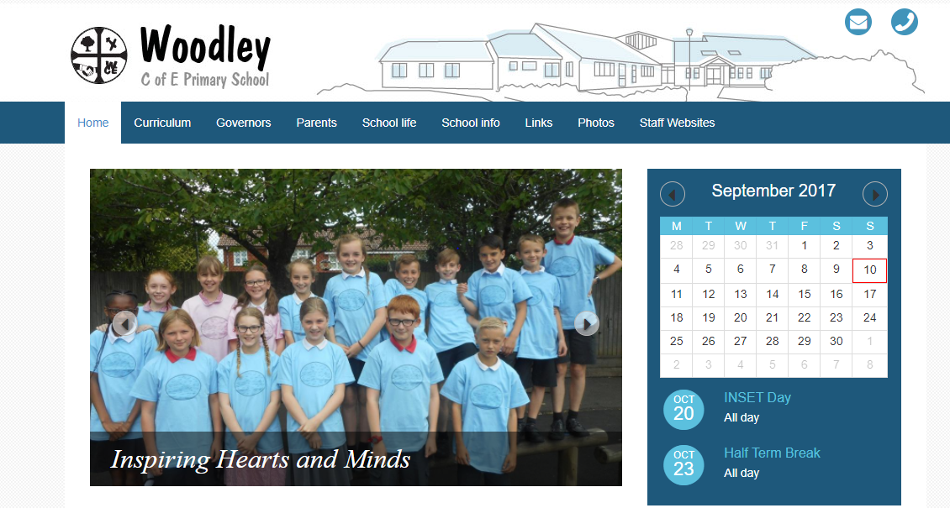
www.woodleyceprimary.co.uk

Slide 24
The Lower Juniors
The children and their happiness is the most important thing to the staff at Woodley C of E.
We endeavour to make learning active and enjoyable.
Homework is meant to develop independent skills not cause arguments.
The teachers work as a team, discuss all of the children together and plan for the development of all children across the department.
Confidence is key.
We are always available to discuss any concerns, please use the home school diary or arrange an appointment through the office. After school is preferable.
Members of staff are in the playground before school to take any important messages or answer day-to-day queries.

Slide 25
Thank you.
Any questions?

