Slide 1
Maths - How to support children at home.
Monday March 4th 2019
6:30pm – 7:30pm

Slide 2
Aims of this session
Look at how we teach maths in school
Think about the application of maths
Consider how you can help at home
Any questions?

Slide 3
Why is maths so important?
The National Curriculum states that
'Mathematics is a creative and highly inter-connected discipline that has been developed over centuries, providing the solution to some of history’s most intriguing problems. It is essential to everyday life, critical to science, technology and engineering, and necessary for financial literacy and most forms of employment. A high-quality mathematics education therefore provides a foundation for understanding the world'
Notes:
The phrases highlighted in red are what we consider to be the key elements of this statement.

Slide 4
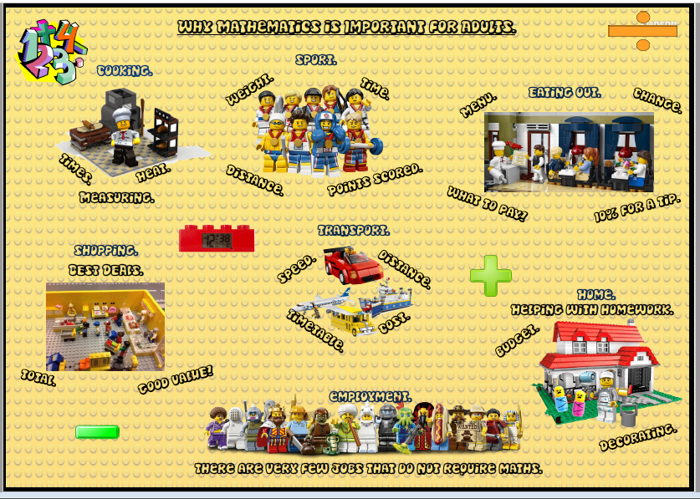
Notes:
In reality, maths is all around us every day.

Slide 5
But ……………………………
Notes:
Unfortunately adults and some children tend to feel they are not good at maths, or that it is a scary subject. This is something we need to change.

Slide 6
Some facts
Children's understanding of and attainment in maths in primary school can have an impact on their success at GCSE
If children are not confident and ‘fluent’ with number by the end of Year 3, it will be more challenging to catch up
Linking and noticing patterns is key to understanding maths
The current maths curriculum focusses on fluency, reasoning and problem solving

Slide 7
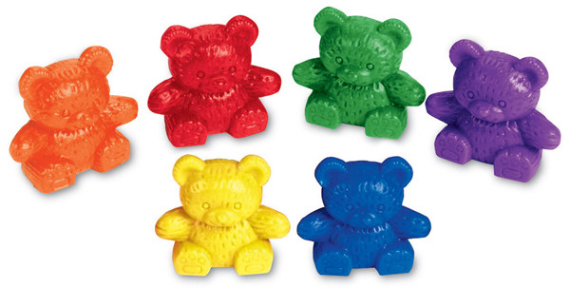
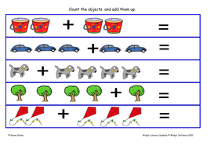
How we teach maths in school
Concrete
Pictorial
Abstract
Notes:
It is important that children start off learning maths with real objects they can handle. When they are ready, they can then move on to pictorial representations of real objects. The final stage is to do maths in abstract scenarios.

Slide 8
It is important to remember
Children do not learn maths in a straight line, but move up and down a continuum
Learning a new method of calculating does not mean other ways are no longer relevant
Children should always be looking for calculations they can do mentally (at least in part)
Based on what we know, as children get older, they can often be less willing to take risks and more reluctant to ask for help

Slide 9
Maths is like a web
Notes:
Maths is like a web – when children learn and understand a concept, it often helps them build their understanding of other concepts.

Slide 10
EYFS (Early Years and Foundation Stage)
As practical as possible
Develop the basics
Count reliably
Recognise numbers
Perform simple calculations
Notes:
It is important that children gain a solid understanding of basic number facts in their first years at school.

Slide 11
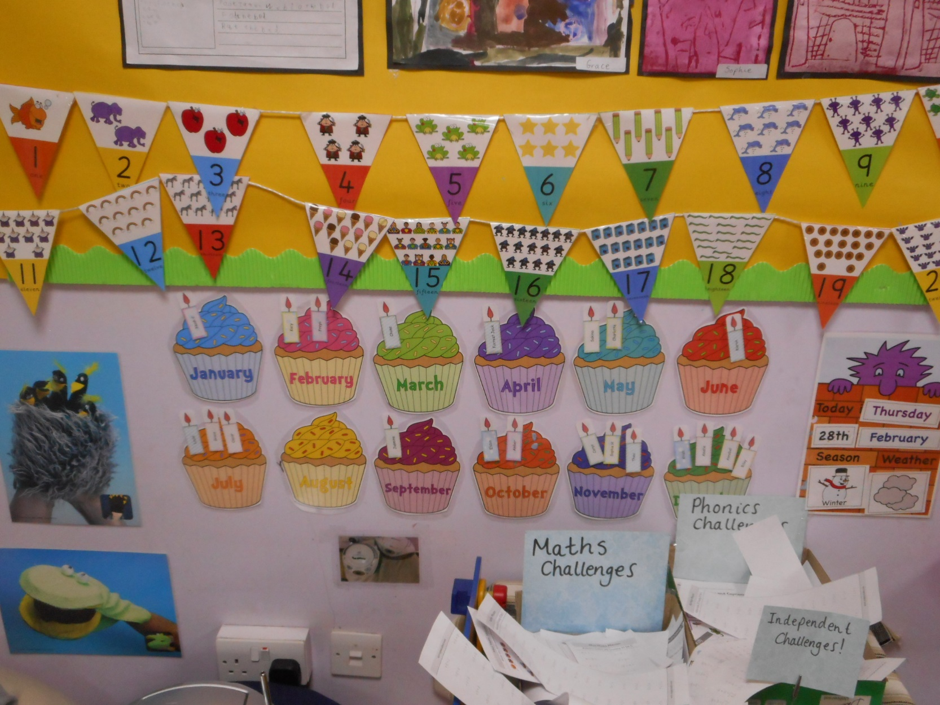
Notes:
Days of the week and months of the year are key facts which children need to remember and recall.

Slide 12
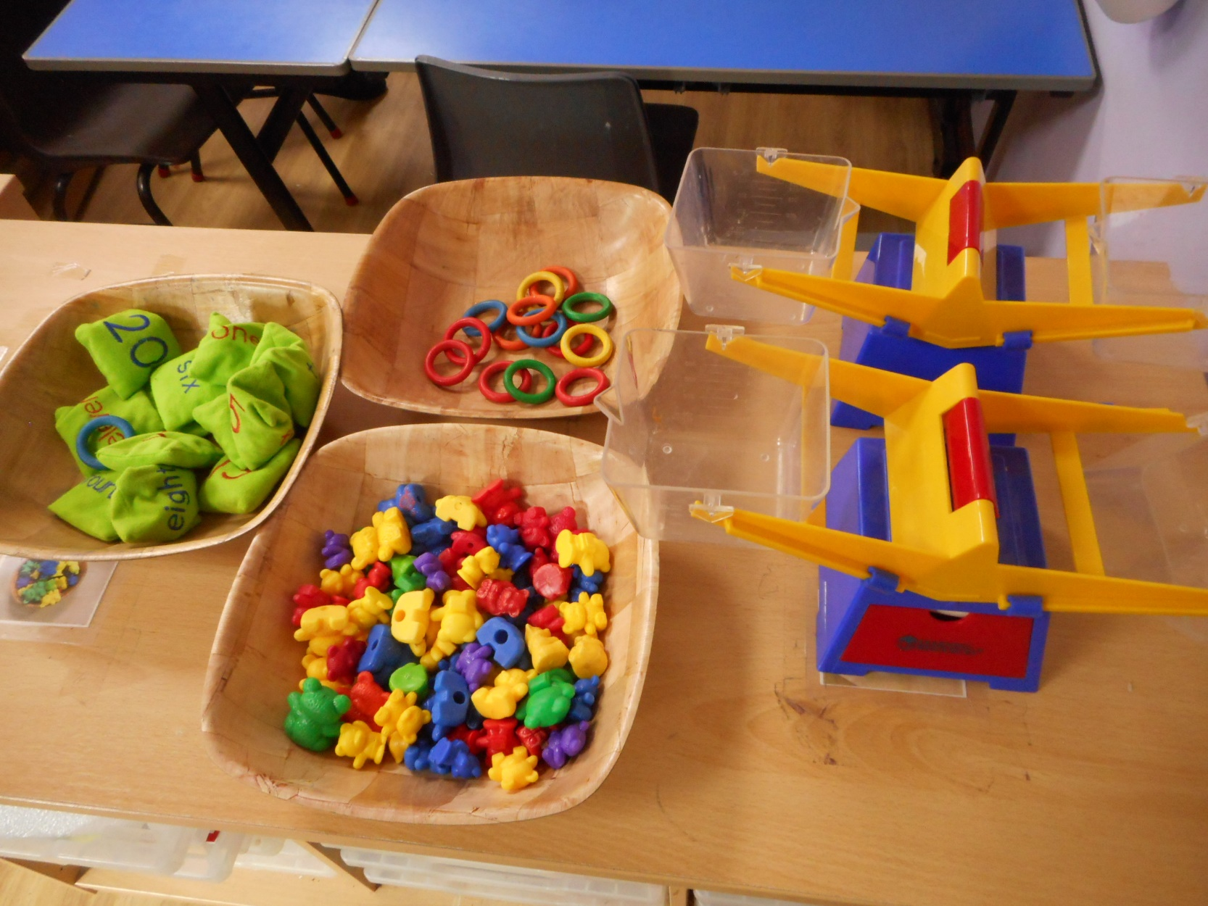
Notes:
Counting with a range of objects can help develop skills.

Slide 13
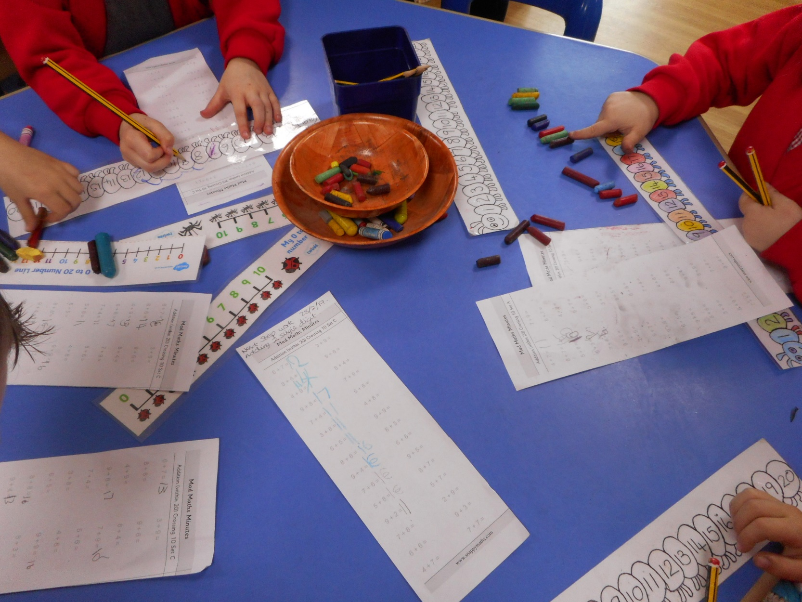
Notes:
Children have the option to choose maths challenges in their free time Here they are using a range of resources to help complete their calculations.

Slide 14
KS1(Years 1 and 2)
Still practical whenever possible
Focus on building a solid maths foundation – the basics
When ready, more reasoning skills are introduced
Challenge learning is encouraged
Notes:
Work on the basics continues in KS1.

Slide 15
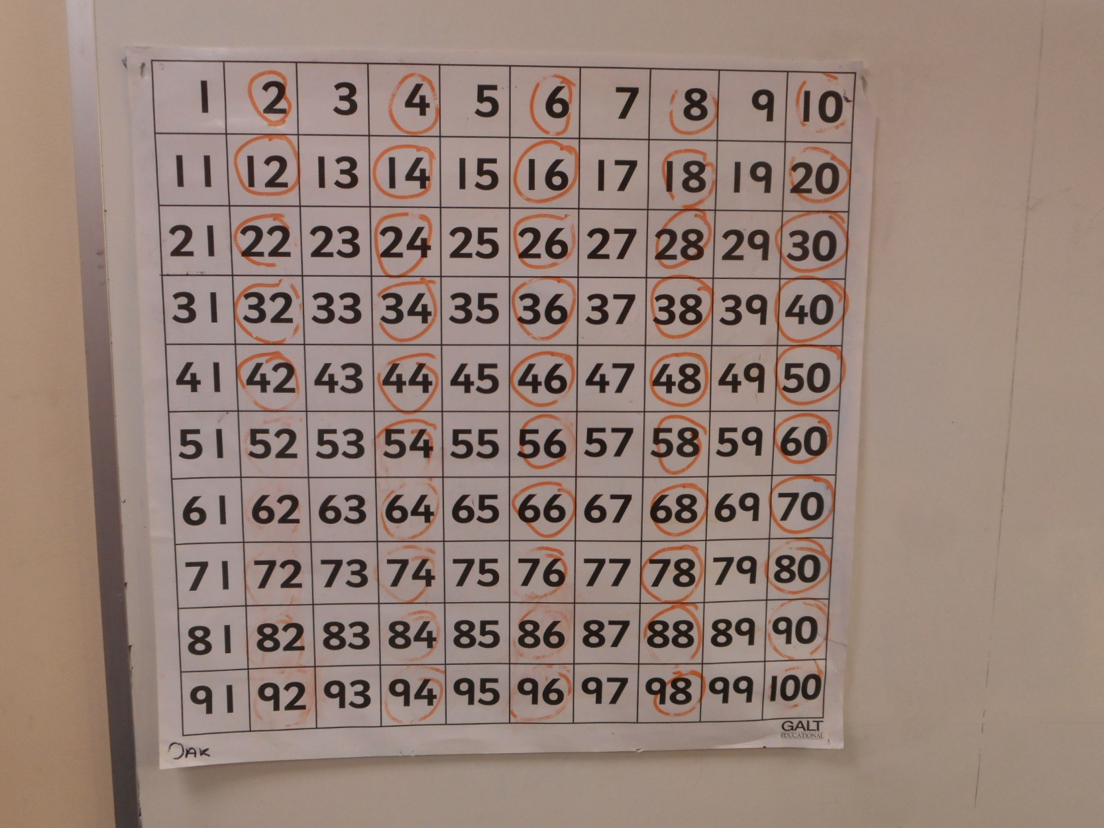
Notes:
Counting in 2s, 5s and 10s is an important skill to ldevelop.

Slide 16
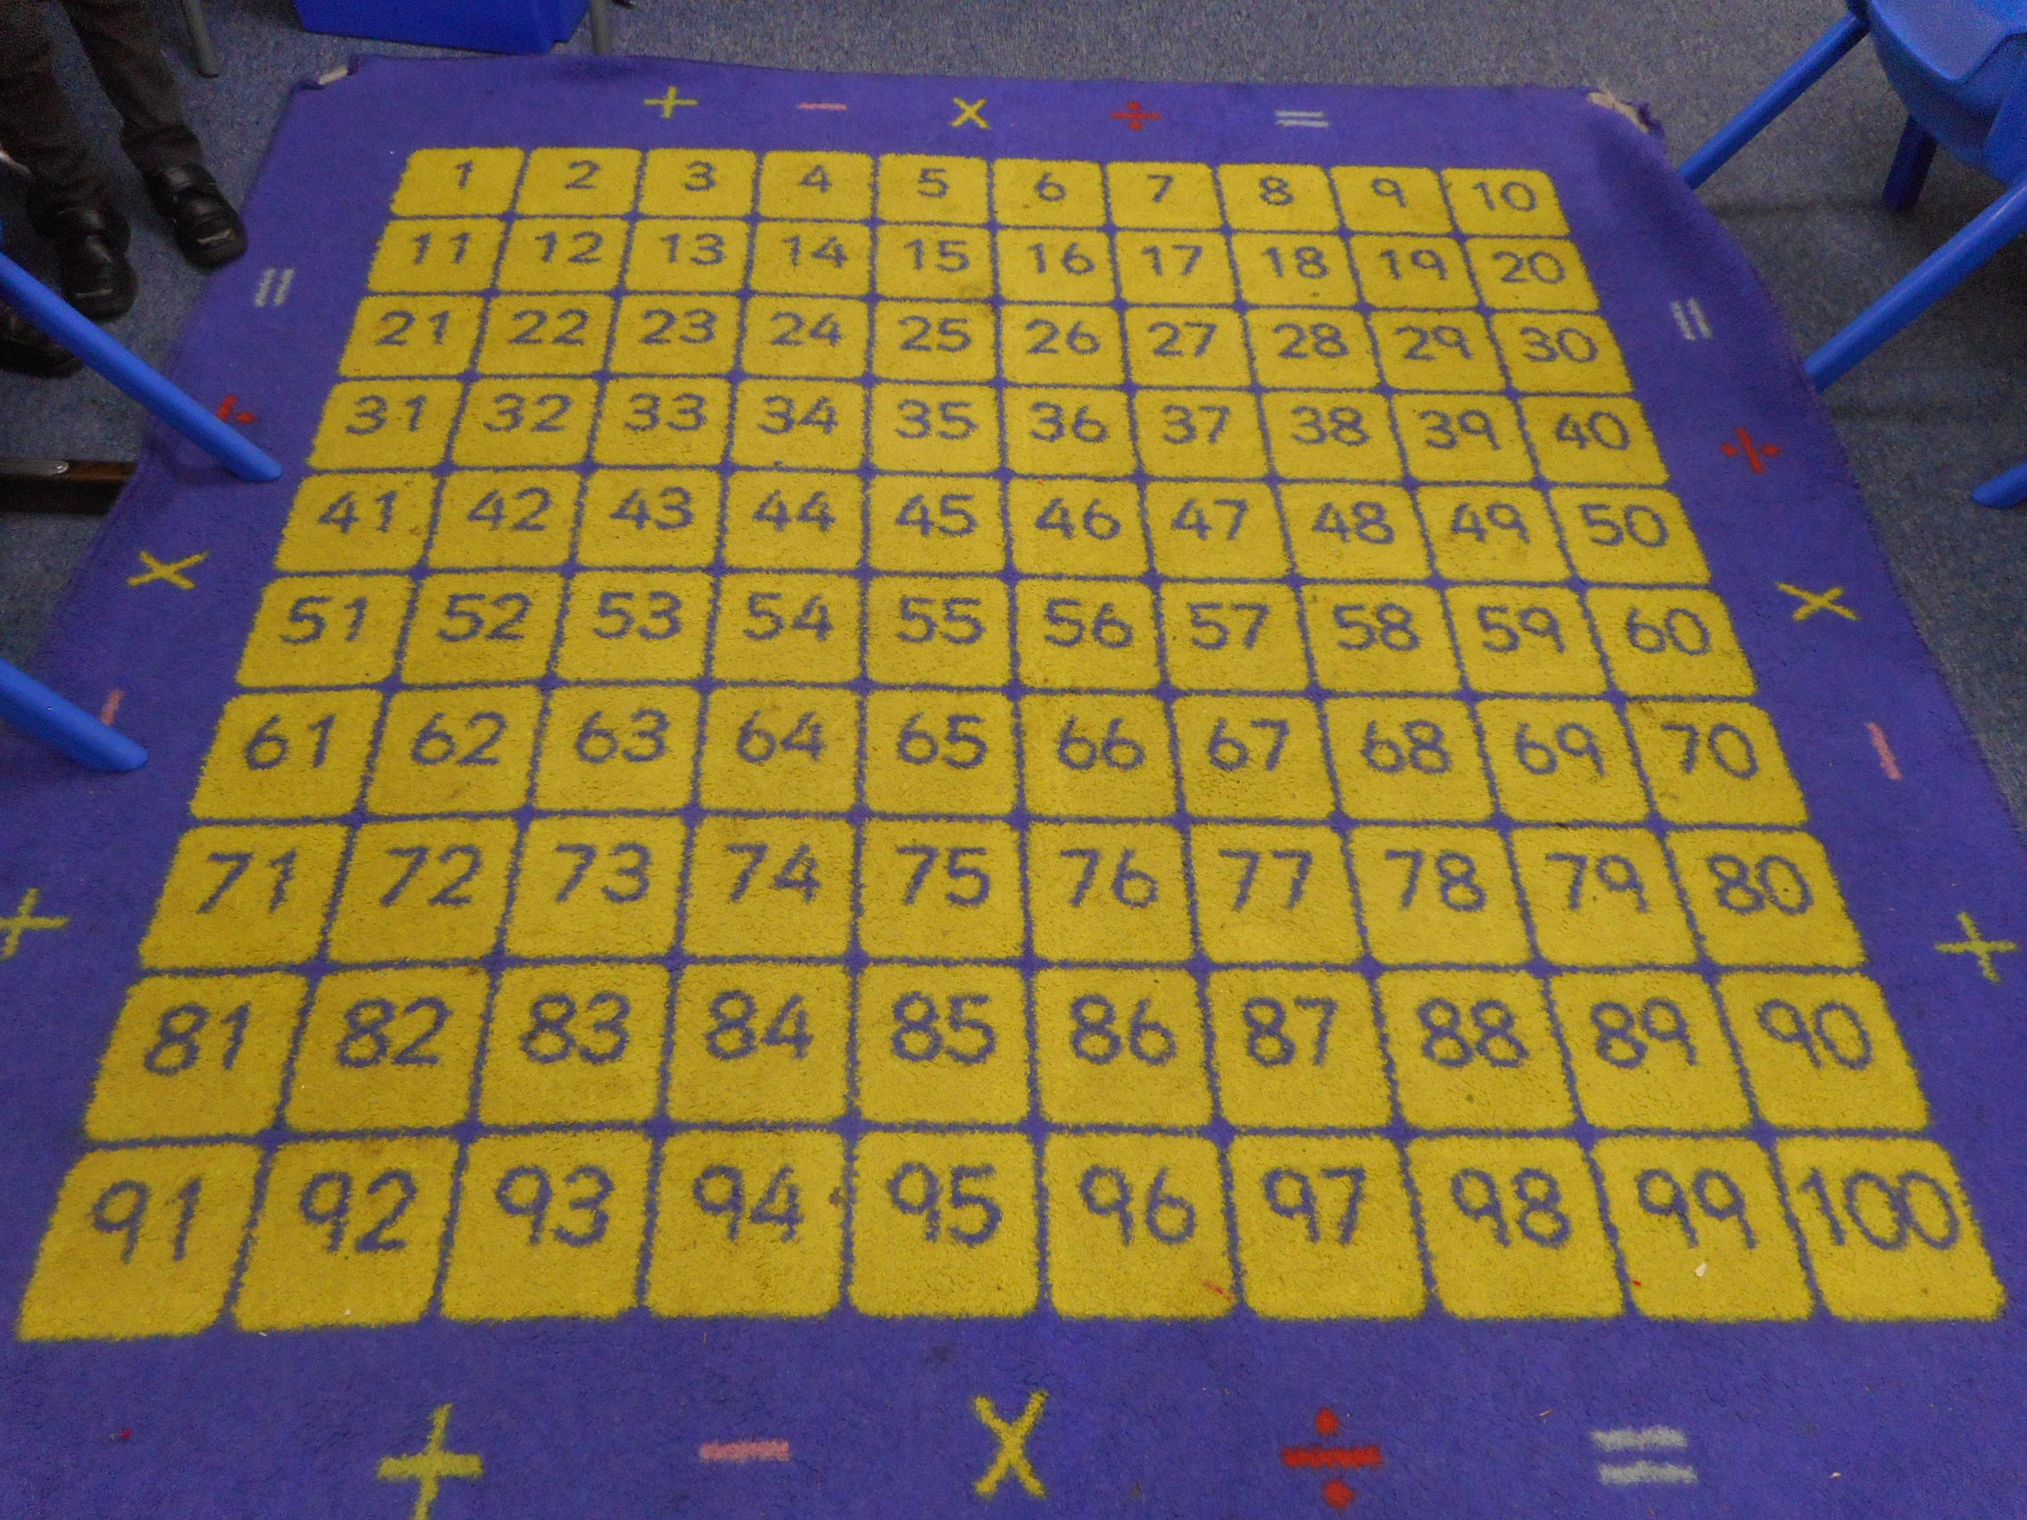
Notes:
Maths mat in kS2 classroom.

Slide 17
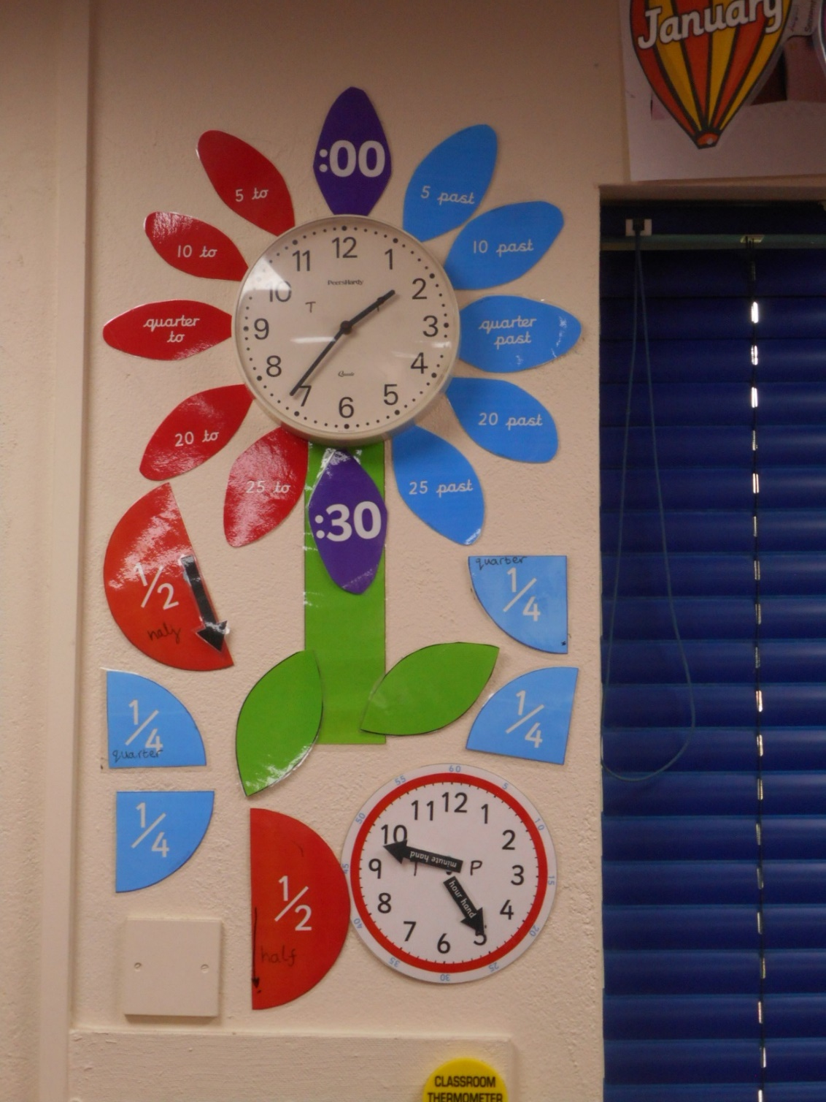
Notes:
Learning to tell the time on an analogue clock is something which can be supported at home.

Slide 18
KS2 (Years 3,4,5 and 6)
Develop more formal written methods of calculation (abstract)
Make independent use of equipment
Improve and consolidate reasoning and problem solving skills
Expand understanding of mathematical concepts
Recording thoughts and calculations on paper is encouraged
Notes:
Children start to learn more abstract concepts as they move up the school.

Slide 19
Notes:
LKS2 maths board/

Slide 20
Notes:
UKS2

Slide 21
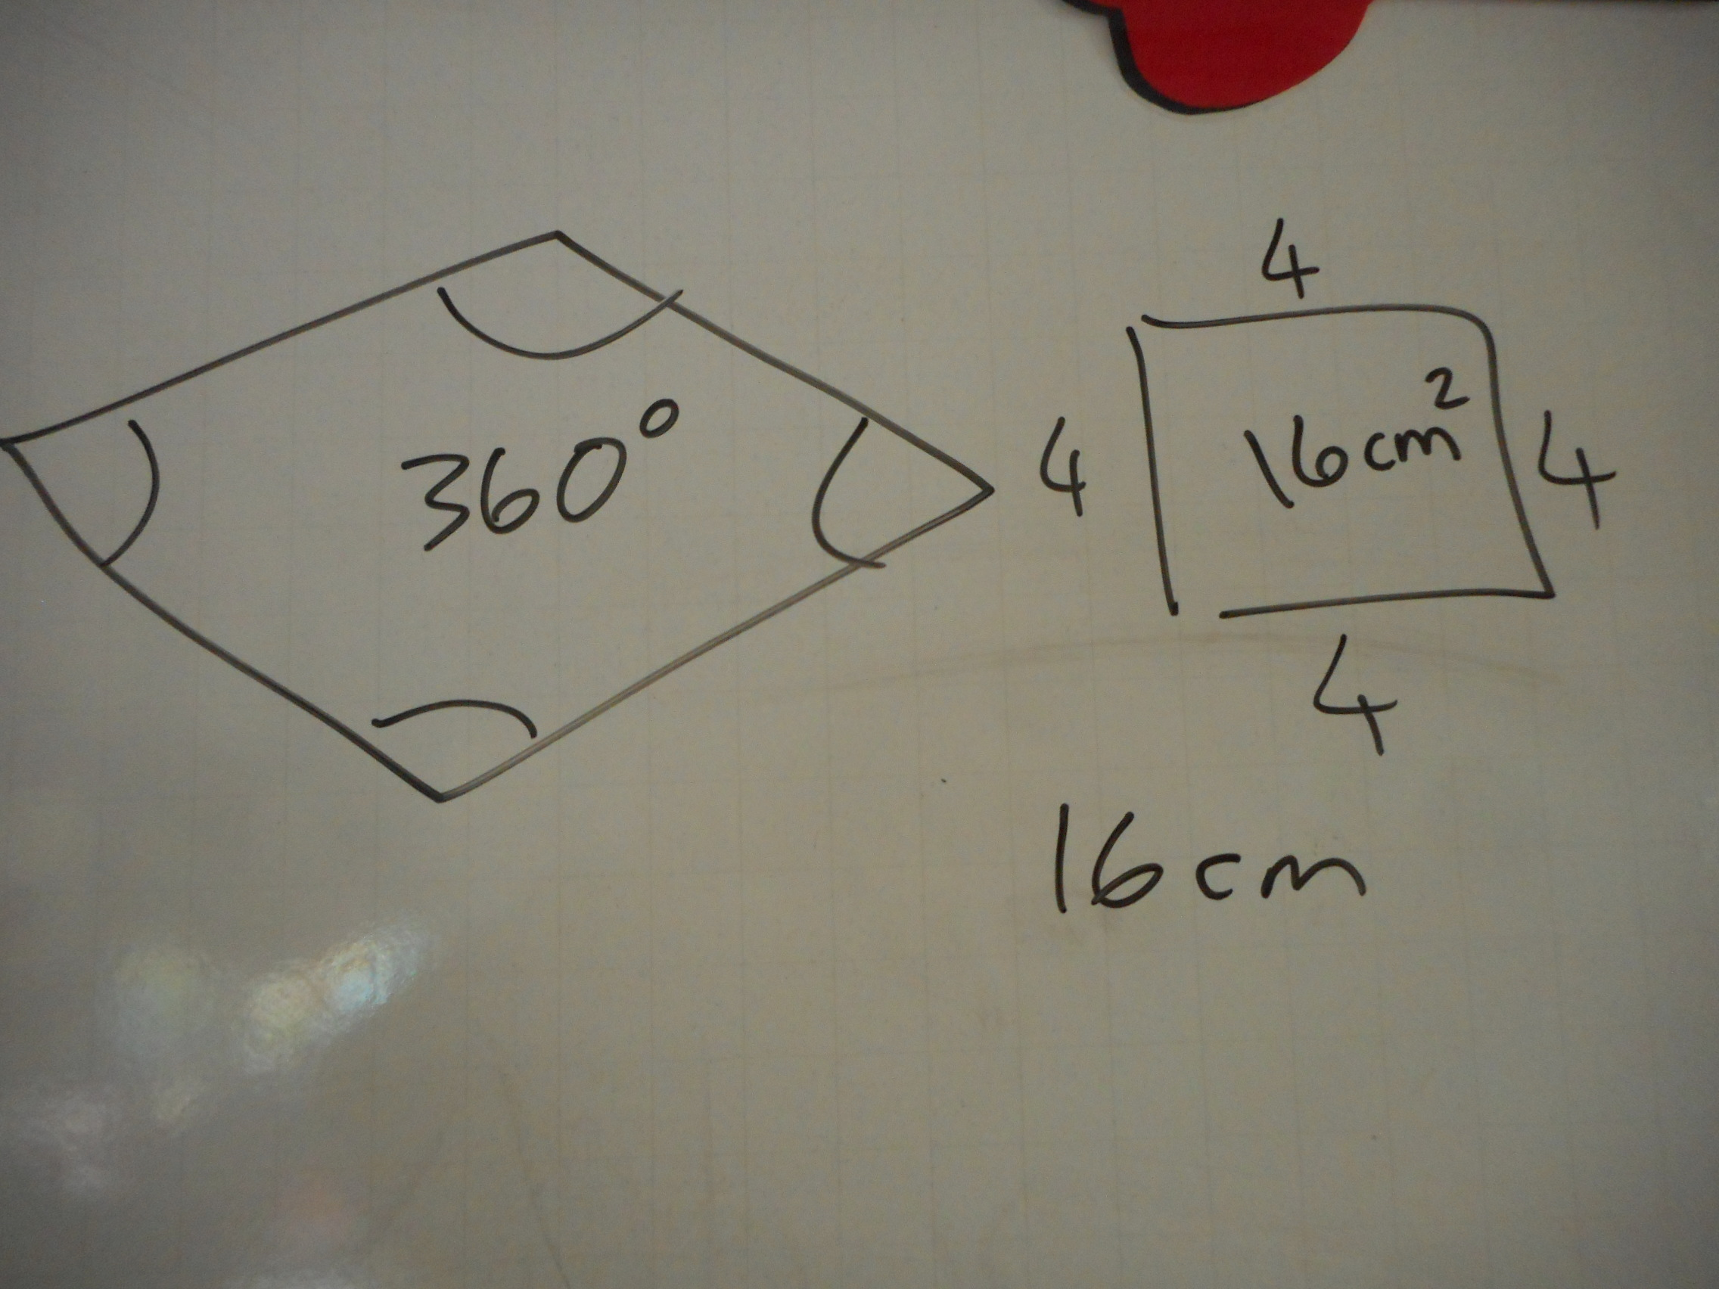
Notes:
UKS2 lesson notes.

Slide 22
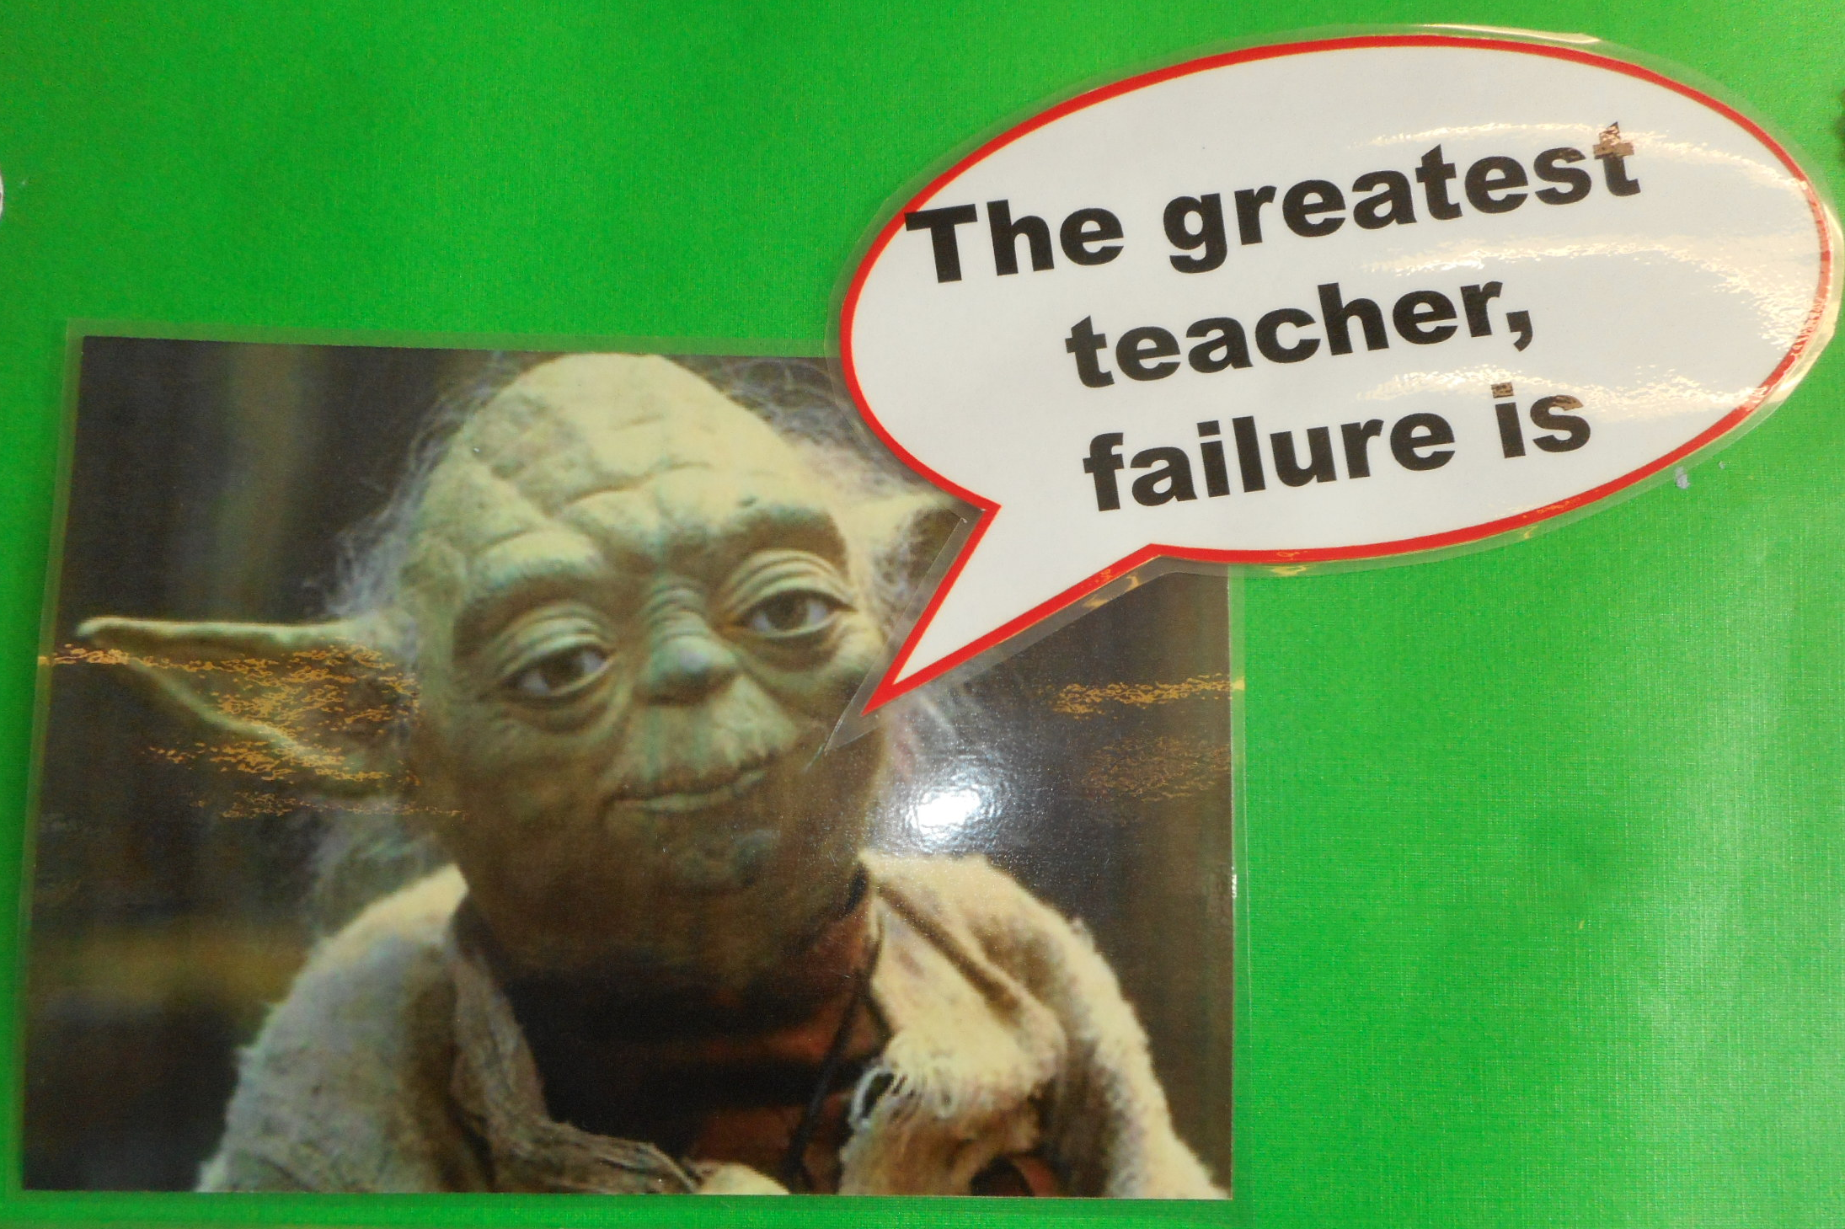
Notes:
It is important that children understand that making mistakes is an important part of the learning process.

Slide 23
Medium term plans
Flexible, depending on the needs of the children
Generally start with Place Value
4 operations (+ - x ÷)
Other areas as appropriate, e.g organised to fit in with topic
Revisit during the year as necessary

Slide 24
Notes:
A dagram to show the approximate time spent on each topic in maths.

Slide 26
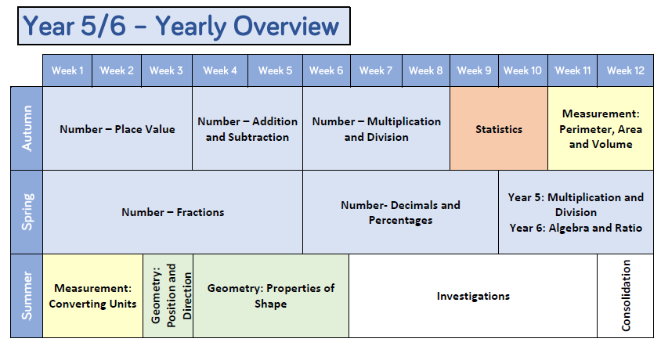

Slide 27
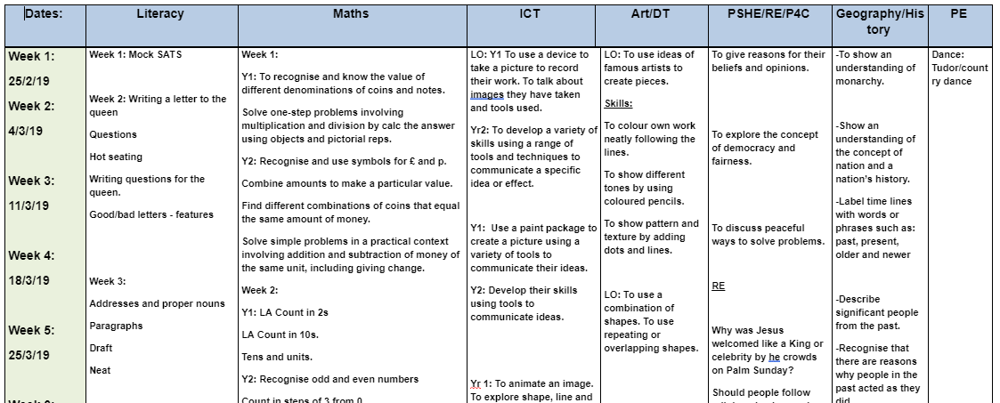
Notes:
KS1 medium term planning example.

Slide 28
Place Value and base 10 number system
Understanding Place Value is key to understanding maths
Notes:
Place Value is key to understanding maths.
There are many Maths antics videos which can be found on line.

Slide 29
On your white boards ……

Slide 30
How would you do?
25x19
5% of 860
248-99
103-98
½ of 378
1+2+3+4+5+6+7+8+9+10+11=
Notes:
Try these at home – there are several different ways these calculations can be tackled.

Slide 31
How about
Notes:
From KS2 SATs paper

Slide 32
or
Notes:
From KS2 SATs paper

Slide 33
Our calculation methods
Are developed on a step by step basis
Are taught when the children are ready to understand them
Refer to the inverse operation as appropriate
Can be adapted to cater for different circumstances
School Website Link to Calculation Methods
Notes:
See link to website for further details.

Slide 34
Vocabulary
Use the correct terms as appropriate
Try and avoid vocabulary misconceptions, e.g. ‘sums’
Use as many different terms for things as possible
Use a maths dictionary (online or paper)

Slide 35
Classic misconceptions
Four hundred and eight is written as 4008 There are no numbers between 2.2 and 2.3
0.625 > 0.9
0.4 is smaller than 0.400 2.1 hours = 2 hours 10 minutes
Shapes with bigger areas have bigger perimeters

Slide 36
Using technology
Maths Apps Link
Notes:
Various websites are used in school and children can access them at home as well.

Slide 37
SATs! (Statutory Assessment Tests)
Children sit national tests at the end of Year 2 and Year 6
KS1 - The tests are a tool for teachers to help them measure your child’s performance and identify their needs as they move into key stage 2. They also allow teachers to see how your child is performing against national expected standards. Take place during May.
KS2 - The tests help measure the progress pupils have made and identify if they need additional support in a certain area. The tests are also used to assess schools’ performance and to produce national performance data. The tests help measure the progress pupils have made and identify if they need additional support in a certain area. The tests are also used to assess schools’ performance and to produce national performance data. Take place on set dates across the country
https://www.gov.uk/government/publications/key-stage-1-and-2-national-curriculum-tests-information-for-parents

Slide 38
Things to do at home
Have a positive attitude to maths yourself – don’t panic!
Have a growth mindset – getting things wrong is a learning opportunity!
Get to know the way maths is taught in school - if you are not sure about something, please ask us
Build maths into everyday activities which are fun!
Provide encouragement and support

Slide 39
Play games (board games, card games)
Do some cooking (weigh ingredients, calculate cooking time, what if? scenarios)
Go shopping (with real money!)
Teach your child to tell the time using an analogue clock as this is still in the curriculum
Help your child to memorise key facts e.g. Times Tables, measurements, days of the week, number bonds etc.
Talk to your children about maths in everyday situations

Slide 40
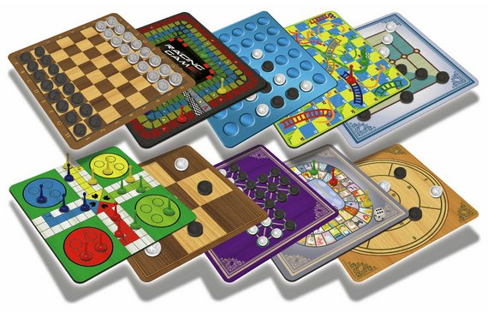
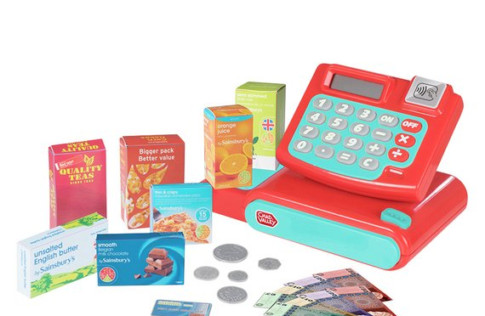
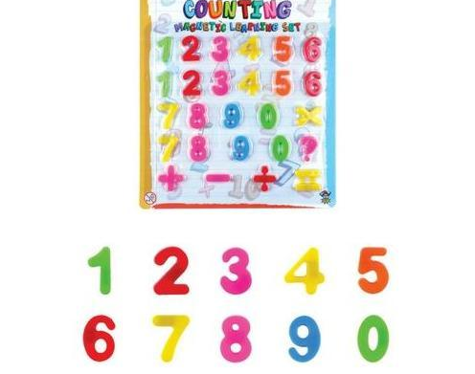
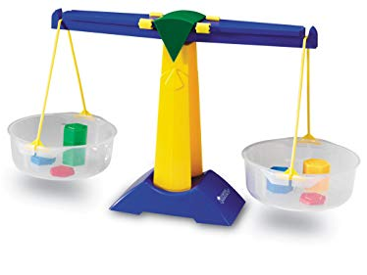
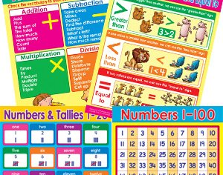
Notes:
There are many different things that can be purchased to support children at home with maths …............

Slide 41
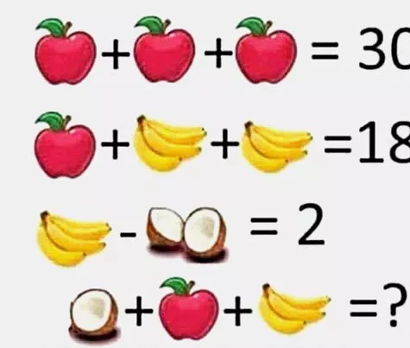
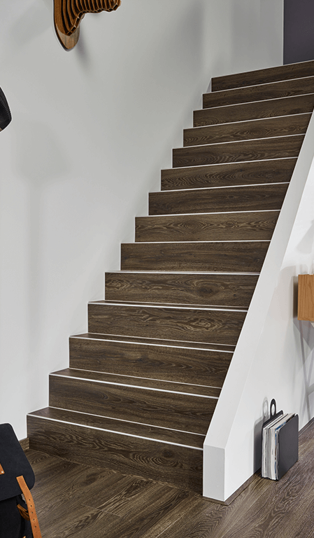
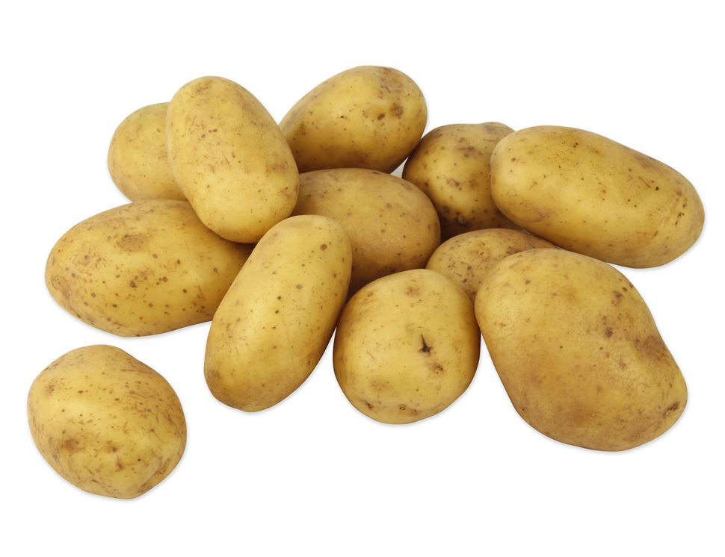
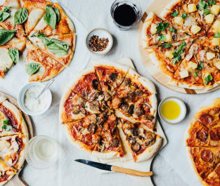
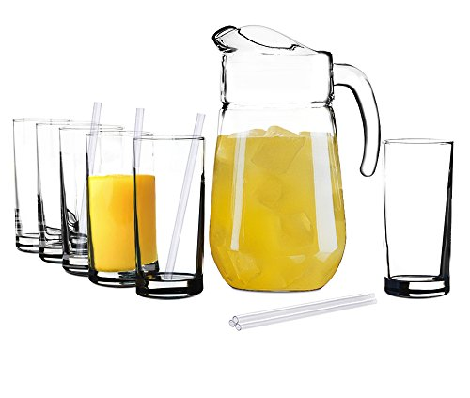
Notes:
But there are many ways to use everyday objects as well, e.g. fractions using pizza, counting in multiples as children walk up the stairs, working out capacity problems using squash etc.

Slide 42
More complex challenges
Work out real life problems together, e.g. how much carpet is needed for a room in your house.
Use an atlas to plan a round-the-World trip; cost, distance, time etc.
Work out % discounts and assess discount offers – which deal is best?
Ask them to write maths problems for you!
Notes:
For children who are confident with maths

Slide 43
Thank you for listening Any questions?
Contact us at admin@woodley-pri.wokingham.sch.uk

Slide 44
A final thought

